Slide 1
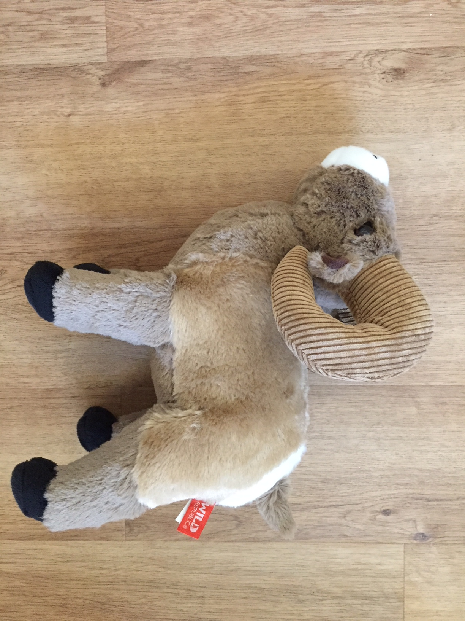
Organisms in a Stuffed Animal

Slide 2
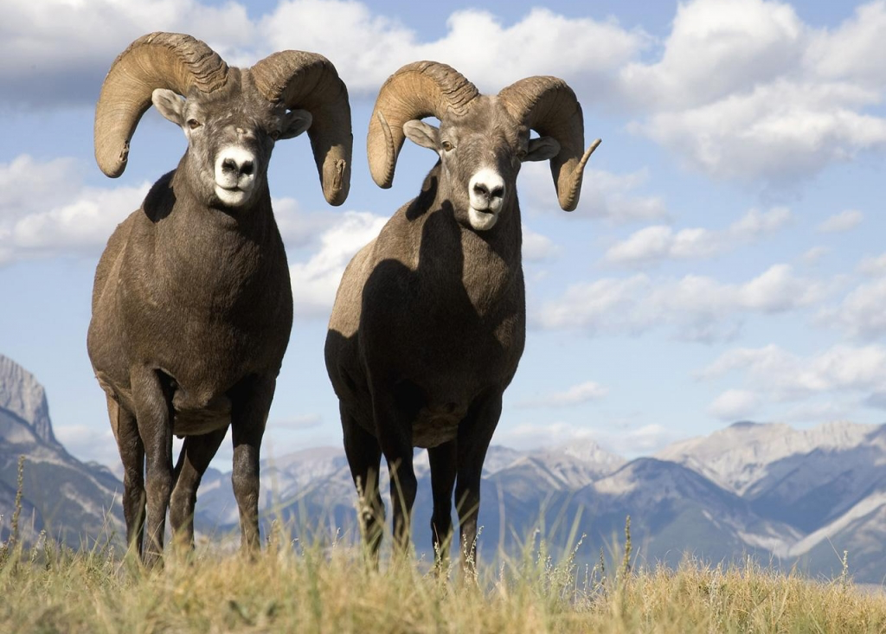
Organisms in Bighorns
Bighorn sheep often are a host to other organisms, giving these other organisms food and shelter and helping them survive.
However, often times the sheep itself suffers from having these organisms on and inside its body.

Slide 3
Bacteria
Pneumonia is one of the biggest hurdles limiting the comeback of bighorn sheep in western North America.
Domestic sheep and goats brought in to graze in bighorn sheep habitat introduce pneumonia to wild sheep.
Mycoplasma ovipneumoniae (M. ovi for short) is a bacteria that makes it easier for bighorn sheep to get infections. Pneumonia is one of those infections.

Slide 4
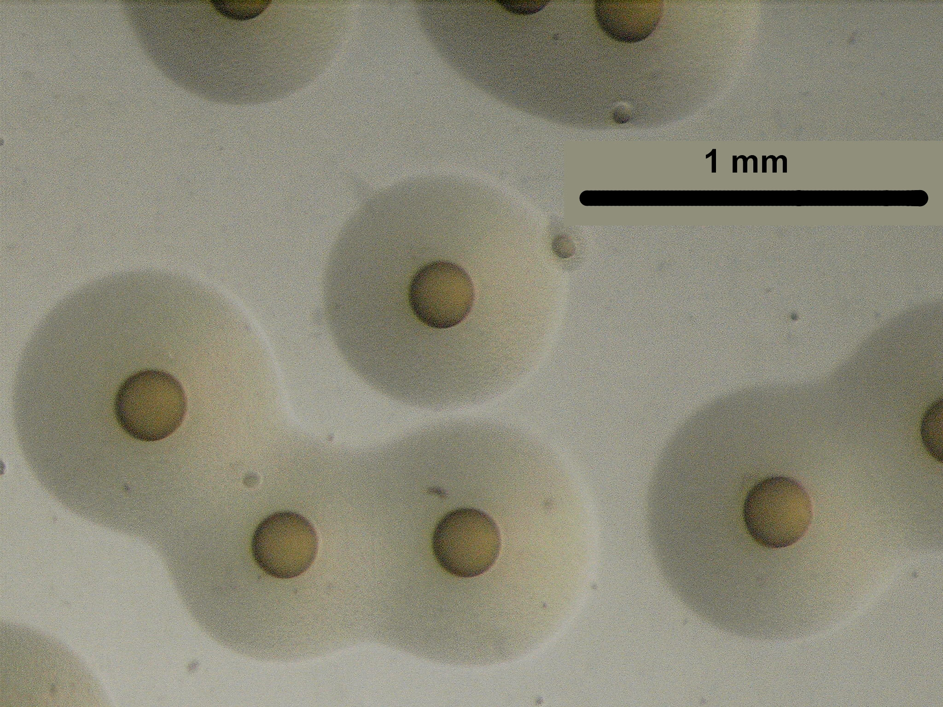
Mycoplasma ovipneumoniae
The bacteria M.ovi in a petri dish.

Slide 5
Pneumonia
Bighorn sheep often die from pneumonia.
Moisture builds up in the lungs and leads to suffocation.
A wild sheep with pneumonia is easy to identify, as it would have a constant cough.

Slide 6
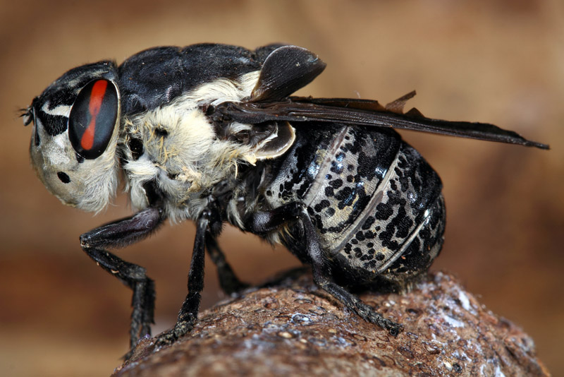
Botfly
Sheep bot flies begin life as eggs and hatch to larvae of 1 mm within the body of the female. The female then deposits a few larvae, while on the wing, within a tiny mucous drop, directly into a nostril of the host animal.
The larvae then make their way up the nasal passage in the mucosa and enter a nasal sinus.

Slide 7
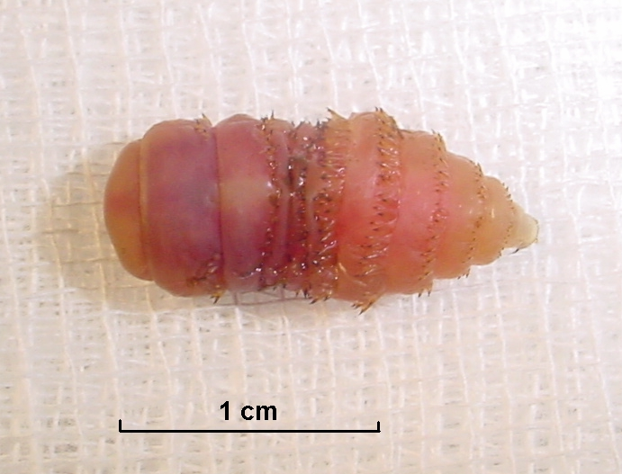
Botfly Larvae
In the nasal sinus it will develop, grow and molt into a second larval stage. It then continues to develop up to 20 mm (apprx. 4/5 inch) in length.
In sheep, the sinuses extend into the horns, so it can get between the bone of the horn and the sheath of the horn. This can begin to cause issues in the horn.
When the larva is fully developed it moves down the nasal passage and drops to the ground where it buries itself and pupates.

Slide 8
The length of time the larva takes to mature is 25–35 days in warm weather but up to 10 months in colder climates. The pupa takes from 3–9 weeks to mature, again dependent on climatic conditions, after which the adult burrows up to the surface, takes to the wing and commences mating.

Slide 9
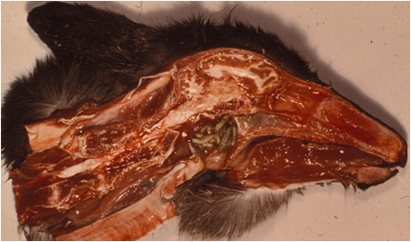
Botfly Larvae in an Elk
Botfly Larvae

Slide 10
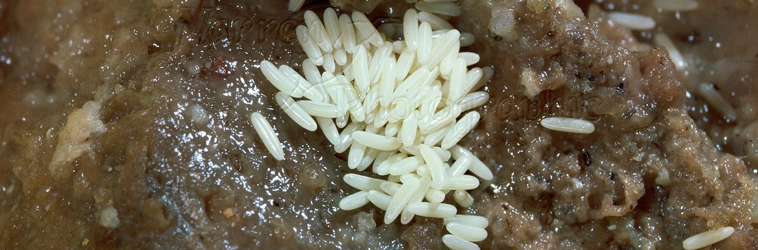
Blow Fly
About 1,100 species of blow fly are known.
Females visit carrion(meat on a dead animal) for egg laying. Blow fly eggs, usually yellowish or white in color, are about 1.5 mm x 0.4 mm, and, when laid, look like rice balls.

Slide 11
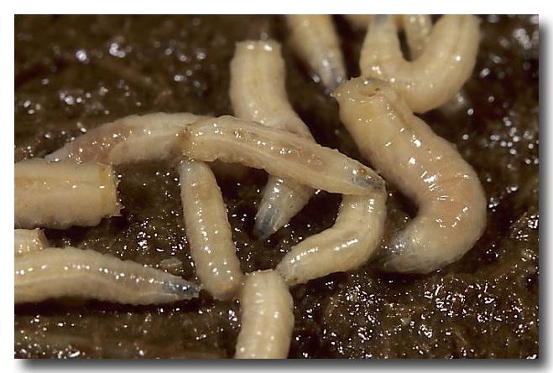
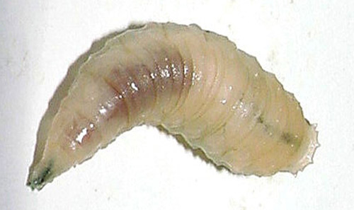
Blow Fly Larvae
A female blow flies lays between 150-200 eggs per batch, which ends up being around 2,000 eggs in her life.
Hatching from an egg to the first larval stage (maggot) takes about eight hours to one day.

Slide 12
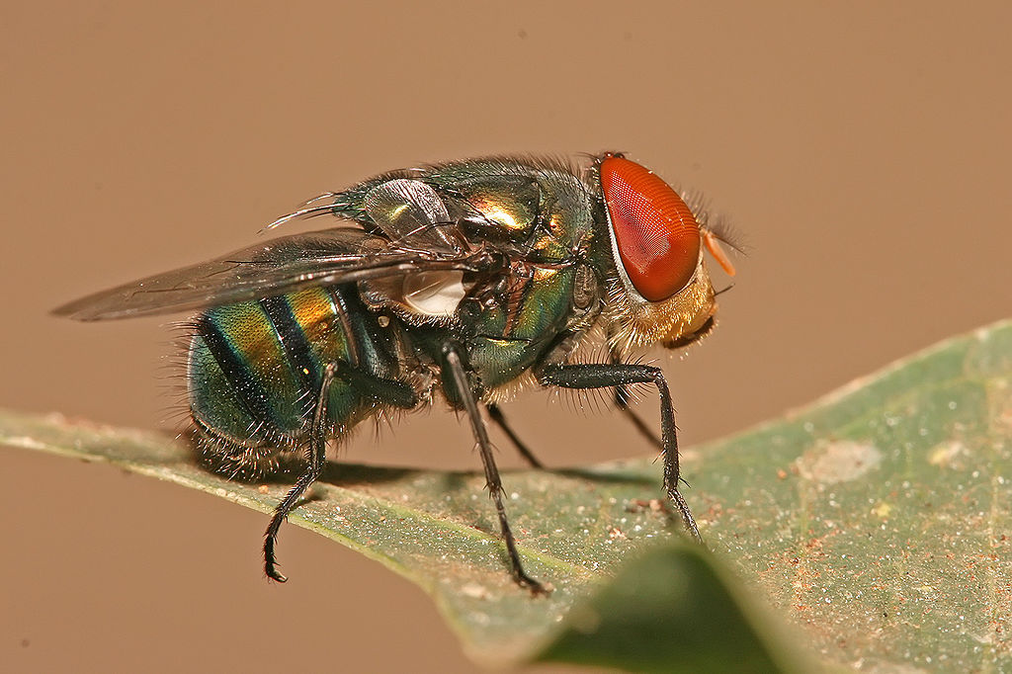
Blow Fly
Larvae of most species are scavengers of carrion (dead animals, included sheep) and dung, and most likely constitute the majority of the maggots found in these materials.

Slide 13
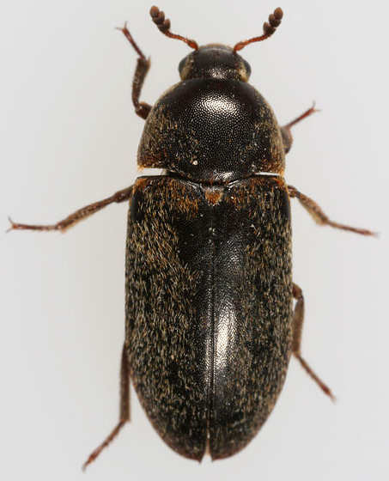
Dermestid Beetle
Like maggots, the dermetsid beetle feeds on dead animals (carrion).
These usually arrive after the blow flies, which are the first to arrive at a dead animal.

Slide 14
Dermestid Beetle
These beetles undergo complete metamorphosis; that is, egg, larval, pupal, and adult stages. The complete life cycle lasts about 45 days per generation.
Adults (beetle looking), lay eggs that are too small to be seen with the naked eye. A few days later very small larvae hatch out which begin looking for their first meal.

Slide 15
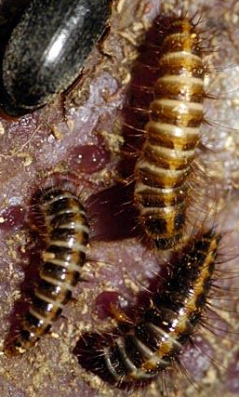
Dermestid Beetle Larvae
The larvae continue eating and molting 8 times before they reach about ¾ of an inch in length.
This growing/molting period lasts about 30 days. It is the larvae that do the majority of the cleaning.

Slide 16
Dermestid Beetle
The large larvae then find a quite spot and pupate.
As they pupate their last outer larvae skin falls off leaving them somewhat yellow in appearance.
7 days later out comes an adult.
Within a day or two the adult is laying 4-5 eggs a day and the whole process begins anew.
The adults live for about 3 months.

Slide 17
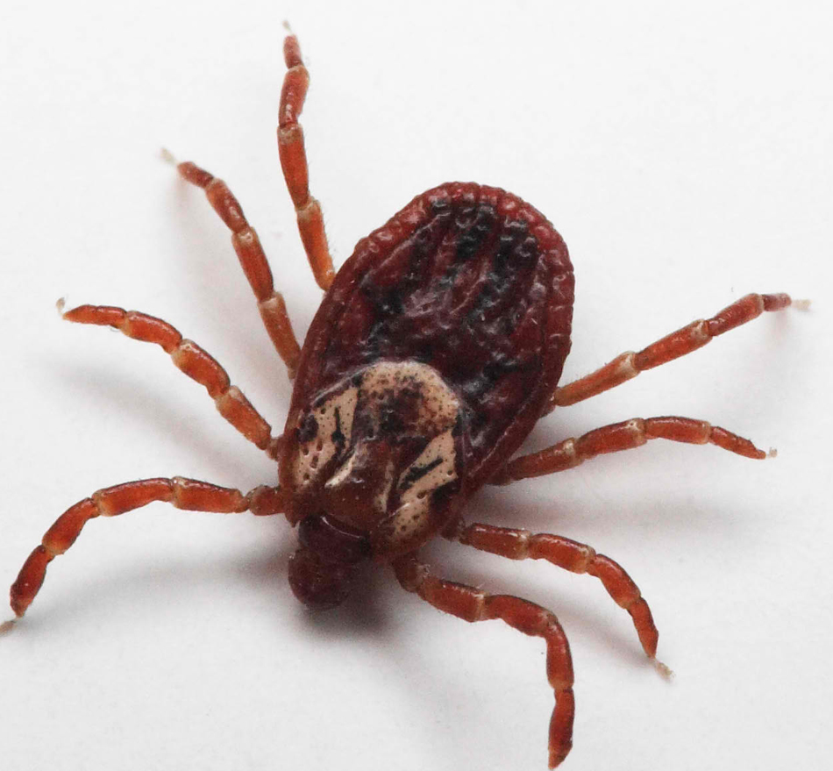
Ticks
Most ticks go through four life stages: egg, six-legged larva, eight-legged nymph, and adult.
After hatching from the eggs, ticks must eat blood at every stage to survive.
Ticks that require this many hosts can take up to 3 years to complete their full life cycle, and most will die because they don’t find a host for their next feeding.

Slide 18
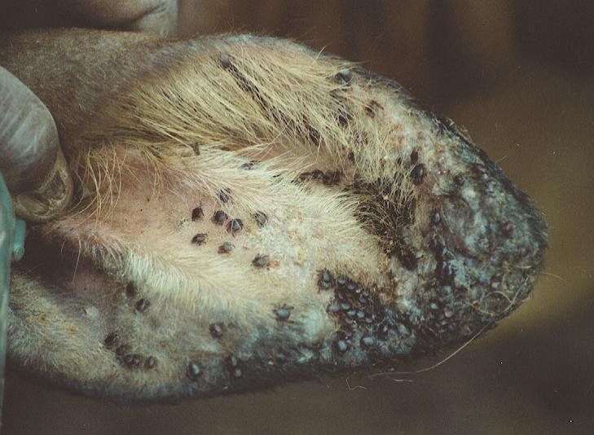
In wild sheep, ticks mainly collect along the ears, where it is easy to get to the soft skin there.
Numbers up to around 70 ticks on one ear can occur.

Slide 19
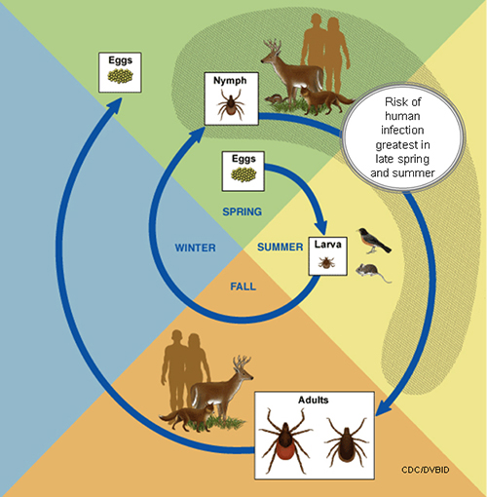
Ticks

Slide 20
How Ticks Find Their Hosts
Ticks find their hosts by detecting animals´ breath and body odors, or by sensing body heat, moisture, and vibrations
Ticks pick a place to wait by identifying well-used paths. Then they wait for a host, resting on the tips of grasses and shrubs..
When a host brushes the spot where a tick is waiting, it quickly climbs aboard. Some ticks will attach quickly and others will wander, looking for places like the ear, or other areas where the skin is thinner.

Slide 21
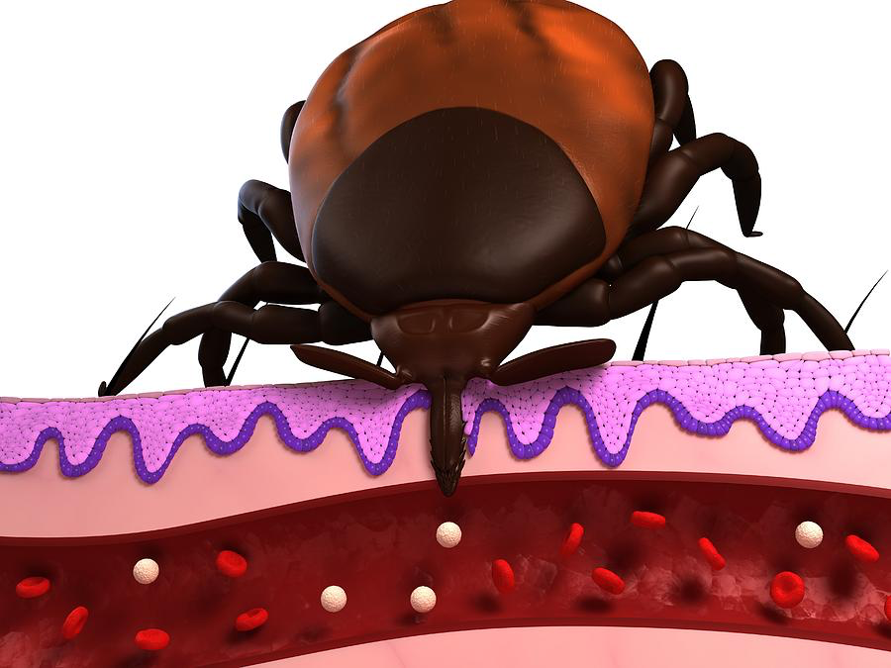
How Ticks Can Spread Diseases
Depending on the tick species and its stage of life, preparing to feed can take from 10 minutes to 2 hours. When the tick finds a feeding spot, it grasps the skin and cuts into the surface.

Slide 22
Spreading Diseases
The tick then inserts its feeding tube. Many species also secrete a cement-like substance that keeps them firmly attached during the meal. The feeding tube can have barbs which help keep the tick in place.
Ticks also can secrete small amounts of saliva with anesthetic properties so that the animal or person can't feel that the tick has attached itself. If the tick is in a sheltered spot, it can go unnoticed.

Slide 23
A tick will suck the blood slowly for several days. If the host animal has a bloodborne infection, the tick will ingest the pathogens with the blood.
Small amounts of saliva from the tick may also enter the skin of the host animal during the feeding process. If the tick contains a pathogen, the organism may be transmitted to the host animal in this way.
After feeding, most ticks will drop off and prepare for the next life stage. At its next feeding, it can then transmit an acquired disease to the new host.

Slide 24
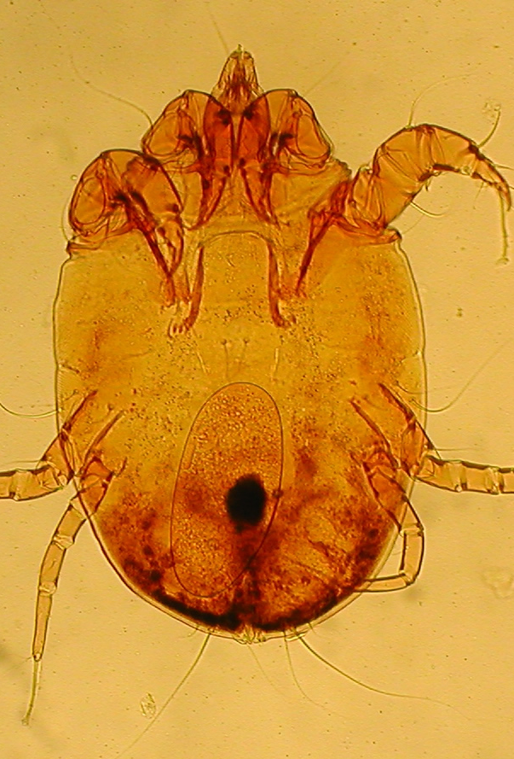
Psoroptes Mite
The microscopic Psoropes mites are responsible for causing psoroptic mange in various animals, including wild sheep.
This is where animals develop heavy crusts in and around their ears and over their bodies, lose hair and body weight, and may lead to death.

Slide 25
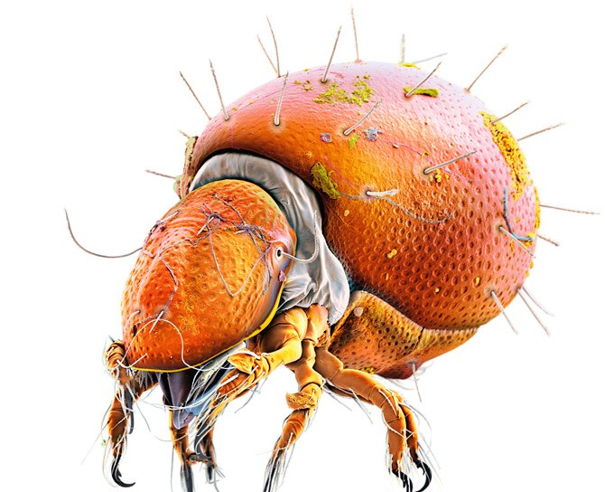
Psoroptes Mite
This entire lifecycle, from egg to egg, takes approximately two weeks, but may vary with environmental conditions.

Slide 26
Psoroptic Mange
Mange can cause intense pain and irritation caused by the bacterial infections; decreased appetite, weight loss, anemia (low red blood cells, which limits amount of oxygen in blood), loss of hair (reduces insulation in winter), and lesions.
Adult sheep can regrow hair and recover with time, but may continue to carry mites, and continue ear rubbing or head shaking.

Slide 27
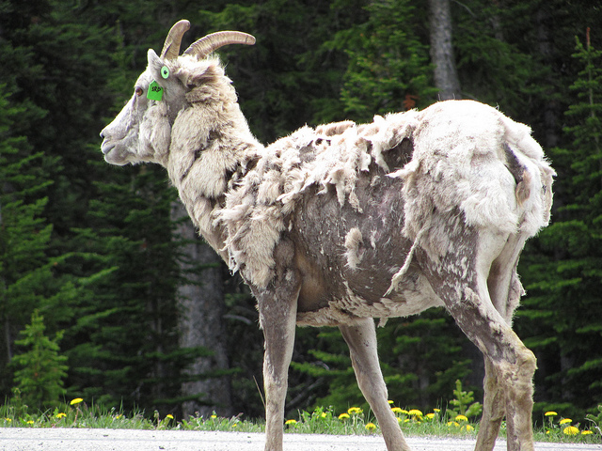
sheep with mange

